Slide 1
A Small Case Study On Credit Card And Fraud Detection Using Machine Learning
Name-Sudhanshu Sekhar Tripathy
Roll No-DF21CSE203
Registration No-2101070009

Slide 2
introduction
Fraud' in credit card transactions is unauthorized and unwanted usage of an account by someone other than the owner of that account. Necessary prevention measures can be taken to stop this abuse and the behaviour of such fraudulent practices can be studied to minimize it and protect against similar occurrences in the future.In other words, Credit Card Fraud can be defined as a case where a person uses someone else’s credit card for personal reasons while the owner and the card issuing authorities are unaware of the fact that the card is being used.
Fraud detection involves monitoring the activities of populations of users in order to estimate, perceive or avoid objectionable behaviour, which consist of fraud, intrusion, and defaulting.

Slide 3
What are Fraud Detection Predictive Models?
Models make predictions based on information about a transaction and some context (historical) information. To make the model more robust, we used only the most important features which were selected based on χ² (a chi-square is a test that measures how expectations compare to actual observed data) and recursive feature elimination techniques.
Neural networks are highly effective when the data scientist has access to a large dataset (say 100,000 or more data samples). They are able to seek patterns and smartly detect new behavior that seems too distinct from the normal flow. However, in our case, we decided to rely on other Machine Learning models such as Classification trees because the RNN(RECURRENT NEURAL NETWORK) performance did not show the accuracy we expected, most likely because of a dataset that was not large enough.

Slide 4
The Fraud Detection market, in general, is tremendous now, and it is expected to expand even further. According to Fortune Business Insights, it will expand up to $106 billion by 2027. North America is a leading region for this market, but Europe and Asia are also considered to be significant players. The growing number of transactions during the COVID-19 lockdowns may boost this number even higher than predicted. Hence, the volume of the transactions globally is highly related to the growth of this market. As of 2021, the biggest shares in the fraud detection and fraud prevention market belong to insurance claims, money laundering, and electronic payments. In this case study, we will focus on how we dealt with challenges in making e-payments more secure for our partners. If you are interested in reading about money-laundering prevention or protection measures in the insurance industries, feel free to leave your comments. We may cover these topics too if you are interested in reading about them

Slide 5
Some of the currently used approaches to detection of such
fraud are:
• Artificial Neural Network
• Fuzzy Logic
• Genetic Algorithm
• Logistic Regression
• Decision tree
• Support Vector Machines
• Bayesian Networks
• Hidden Markov Model
• K-Nearest Neighbour

Slide 7
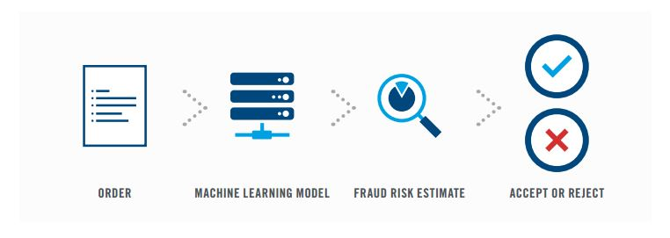
Anomaly Detection Solution for E-Commerce Credit Card

Slide 8
Challenges
To dive into the challenges and obstacles of this project, we got a quote from a Machine Learning Engineer from our development team:
“The most complicated part of the solution was to achieve good metrics for users who have made only a few transactions. We could apply the regular model, which is good for users with a rich transaction history, but it would give worse scores if there is a lack of historical data (for example, a new user). Another obvious solution is to treat such users as empty accounts that have only identity information without any transaction history. In this case, we lose the advantage of having at least some data about the users, but the results that such a model provides are quite stable (underfitting). After making a weekly stand up on the matter, we decided to look into ‘few-shot learning’ techniques, which could help us improve our metrics. We have prepared a PoC, but it didn’t give us the drastic improvement we had expected. Nevertheless, we proceeded with experimenting and diving into our client business domain; it allowed us to develop features which have made a huge impact on our model that is based on ‘few-shot learning’ techniques. Because of the domain features, our main score improved by more than 15% and it became the production solution”.

Slide 9
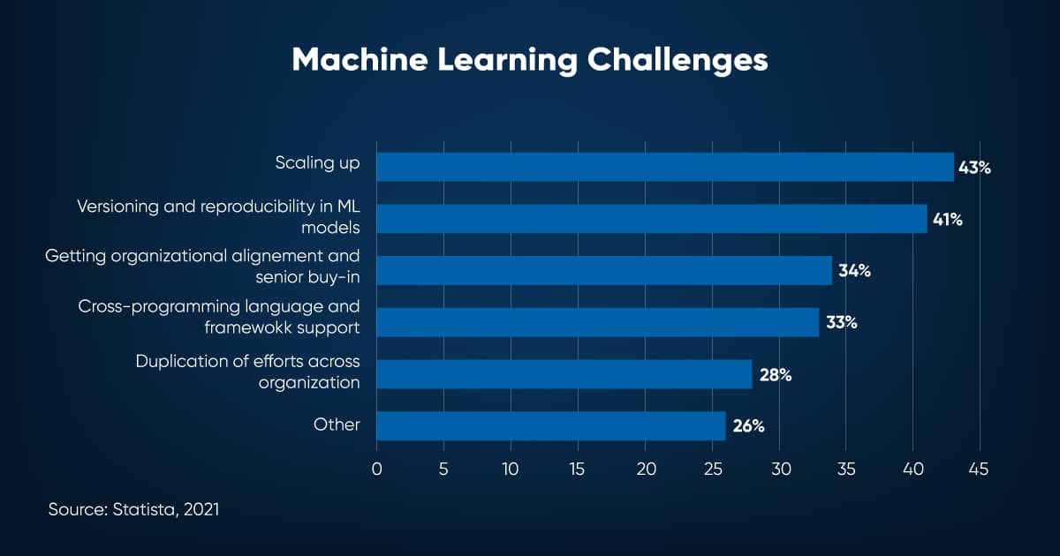

Slide 10
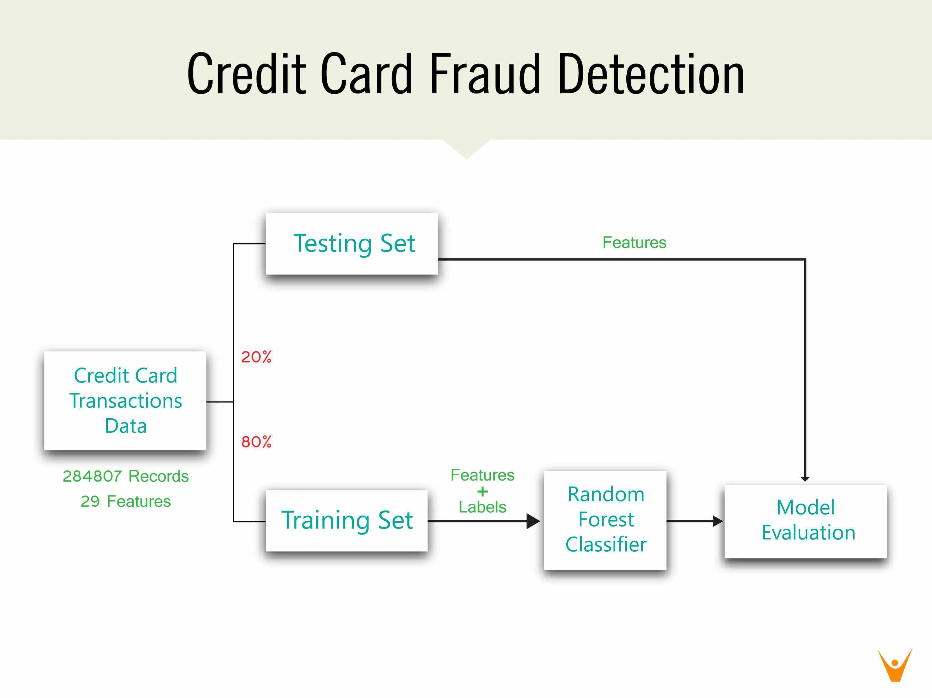

Slide 11
Credit card Fraud Detection Dataset
The platform is an e-commerce and financial service app serving 12,000+ customers daily. This dataset included a sample of approximately 140,000 transactions that occurred between October 2018 and April 2019. One of the fraud detection challenges is that the data is highly imbalanced. There were around 130,000 normal transactions and only 6% of them were fraudulent. We addressed the problem of an imbalanced dataset with various techniques such as data oversampling (augmenting the existing data samples) and data sample generation.

Slide 12
Credit Card Fraud Detection Algorithm
Once the Machine Learning-driven fraud protection module was integrated into the e-commerce platform, it started tracking the transactions. Whenever a user requests a transaction, it is being processed for some time. Depending on the level of predicted fraud probability, there are 3 kinds of possible output:
If the probability is less than 10%, the transaction is allowed
If the probability is between 10% and 80%, an additional authentication factor (e.g. a one-time SMS code, a fingerprint, or a secret question) should be applied.
If the probability is more than 80%, the transaction is frozen, so it should be processed manually.
The model estimates the probability of a fraudulent transaction based on the following transaction information: Date and Time, Product Category, Amount, Provider (Seller), Client Information, Agent Information, Location, and Client’s Behavioral Patterns. Contextual and aggregated data is produced by a Machine Learning engineer based on the previously mentioned data.

Slide 13
Fraud Detection Machine Learning: What to Look for in 2021-2022?
This Fraud Detection Machine Learning case study is merely one of many examples of how the technology can benefit an organization. While looking into the future, it is safe to say that Artificial Intelligence and Machine Learning will dominate the Fraud Detection field if companies adjust their culture and embrace the power of innovation. Keep in mind that Artificial Intelligence/Machine Learning can always be combined with powerful technologies such as Cloud Computing and Big Data, which will provide better efficiency.

Slide 14
Contd…
As criminals always find new inventive ways to steal money, Machine Learning-based solutions with supervised and unsupervised techniques will help find hidden patterns and provide even more complex insights. Deep Learning technology is already altering this field by making conclusions built on user behavioral, historical, and time-series data and most likely will become even more effective in 2021. Probably, the biggest advantage of Artificial Intelligence/Machine Learning solutions is that you can combine different kinds to secure maximum efficiency for your organization. According to Fortune Business Insights, the global Machine Learning market will exceed $117 billion in the next six years. However, seamless adoption presents some significant challenges:

Slide 15
Conclusion
Credit card fraud is without a doubt an act of criminal dishonesty. This case study has listed out the most common methods of fraud along with their detection methods and reviewed recent findings in this field. This case study has also explained in detail, how machine learning can be applied to get better results in fraud detection along with the algorithm,pseudocode,explanation its implementation and experimentation results.While the algorithm does reach over 99.6% accuracy, its precision remains only at 28% when a tenth of the data set is taken into consideration. However, when the entire dataset is fed into the algorithm, the precision rises to 33%. This high percentage of accuracy is to be expected due to the huge imbalance between the number of valid and number of genuine transactions.
Since the entire dataset consists of only two days’ transaction records, its only a fraction of data that can be made available if this project were to be used on a commercial scale. Being based on machine learning algorithms, the program will only increase its efficiency over time as more data is put into it.

Slide 16
THANK YOU FOR LISTENING

